Slide 1
Tutorial for case 4
Multi-solvent design for perovskite thin film materials

Slide 2
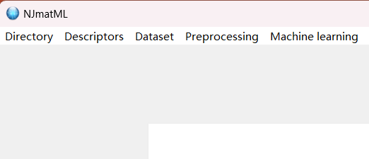
Choose your save path
Click this button and choose your save path

Slide 3
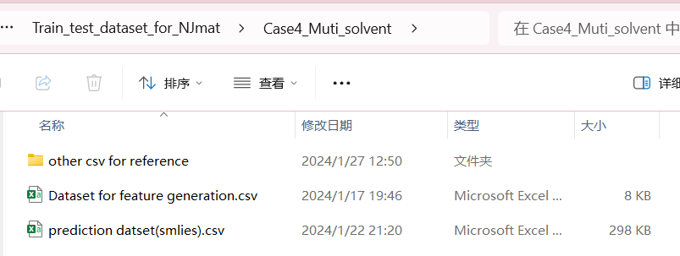
Data import for feature generation
Choose this dataset!

Slide 4
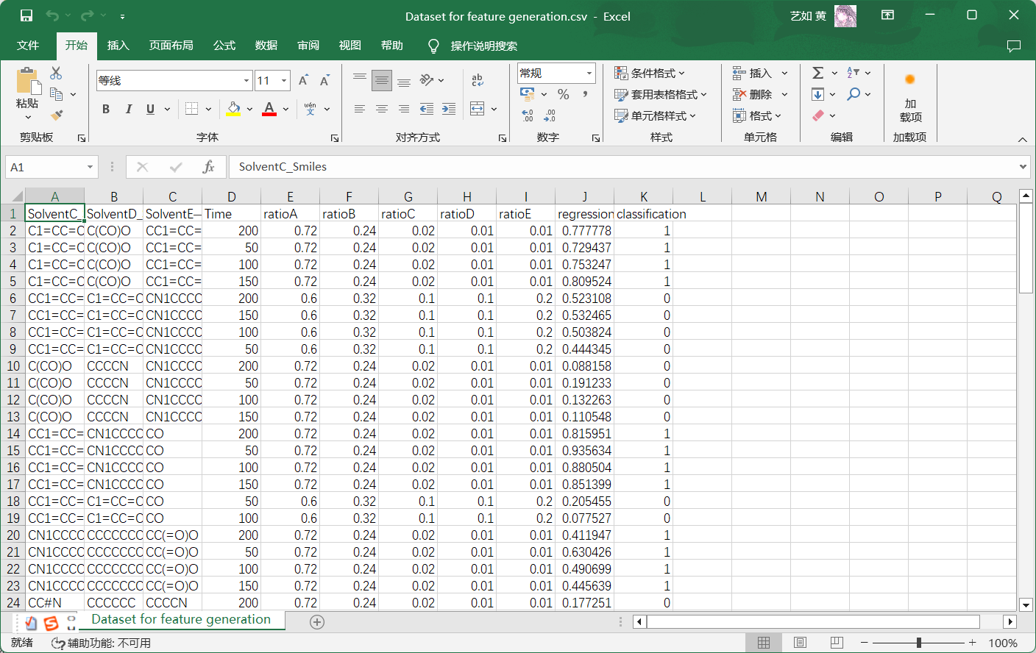
Dataset display
Smiles codes for molecules
Other experimental variables

Slide 5
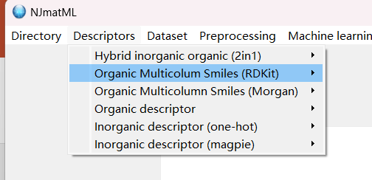
Feature generation
Click this button and import data

Slide 6
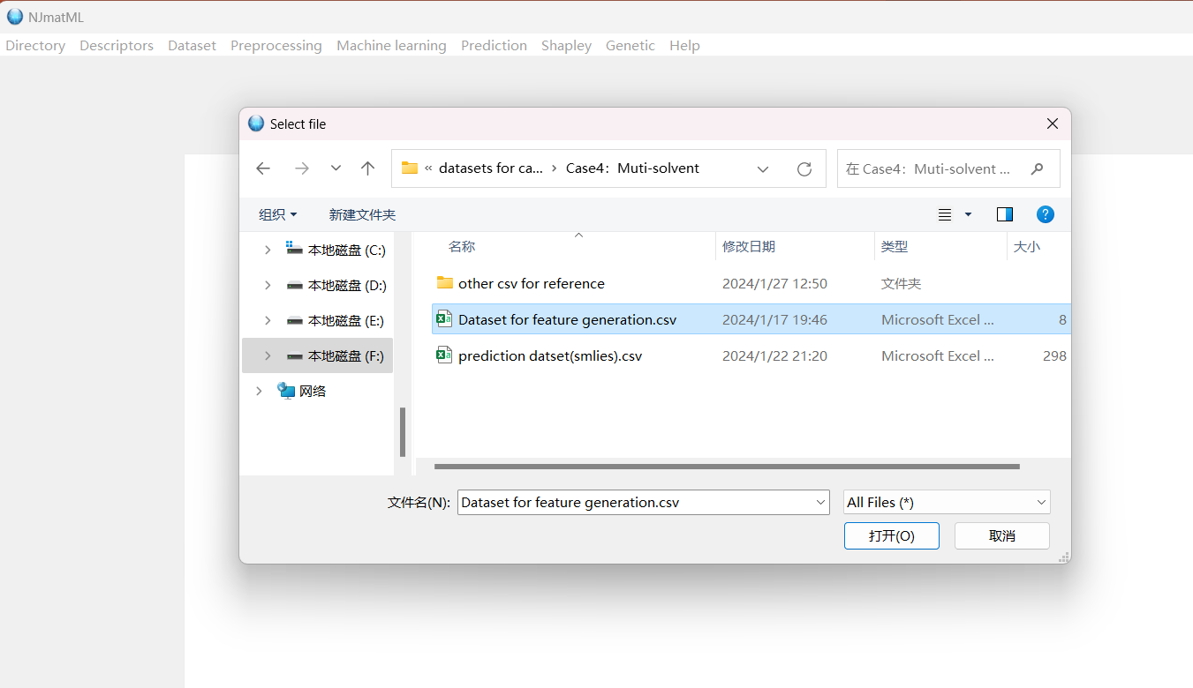
Feature generation
Data import
After data import, click button ‘featurize’!

Slide 7
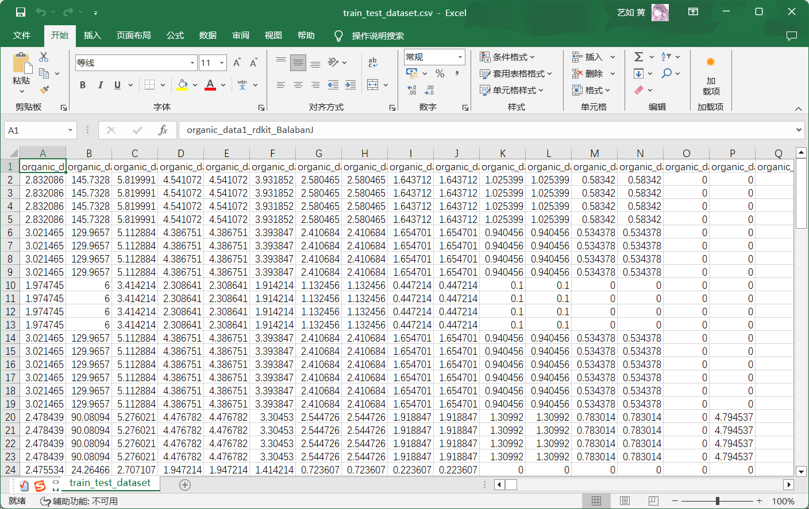
Feature generation display
Feature generation finish and the file is named as “train_teat_dataset.csv”

Slide 8
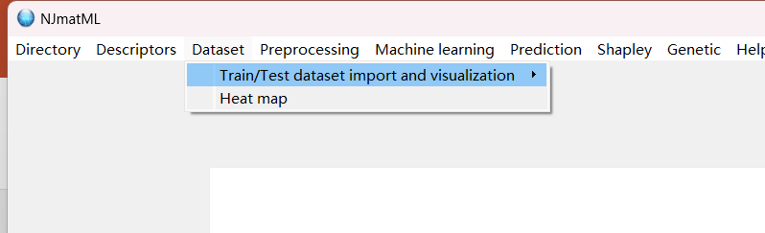
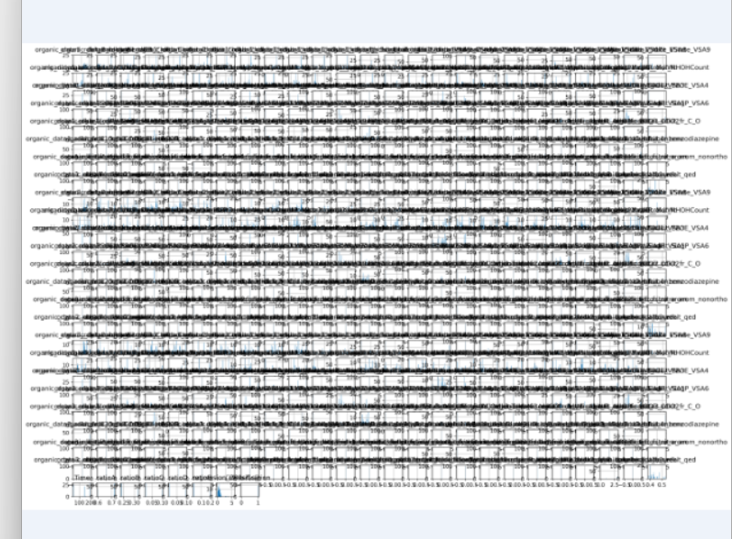
Data import and visualization
Click this button, and import “train_teat_dataset.csv”
After import the dataset, click the button “visualize”, you can gain a data visualization plot:

Slide 9
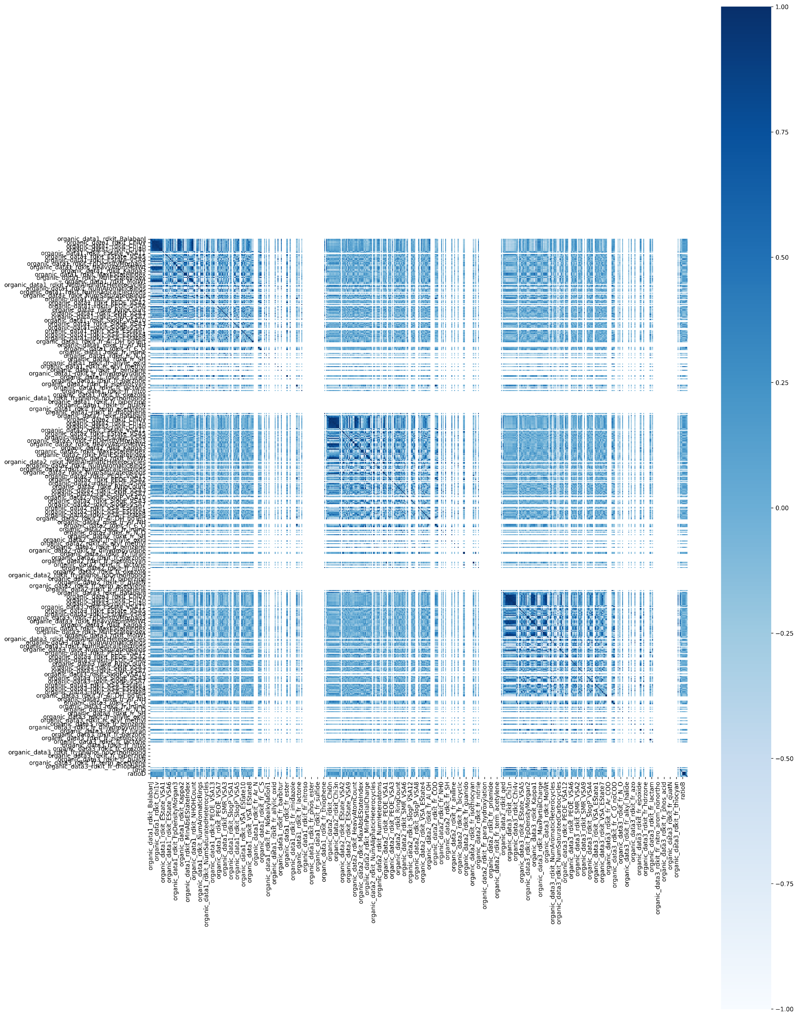
Data import and visualization
After data visualization, you can gain heatmap by clicking button “Heat map”

Slide 10
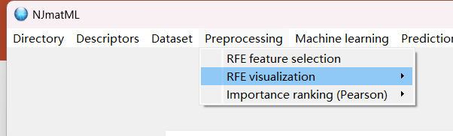
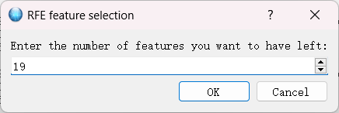
Feature selection
Clicking this button “RFE feature selection ”
Input “19”, actually you can select as many feature as you want

Slide 11
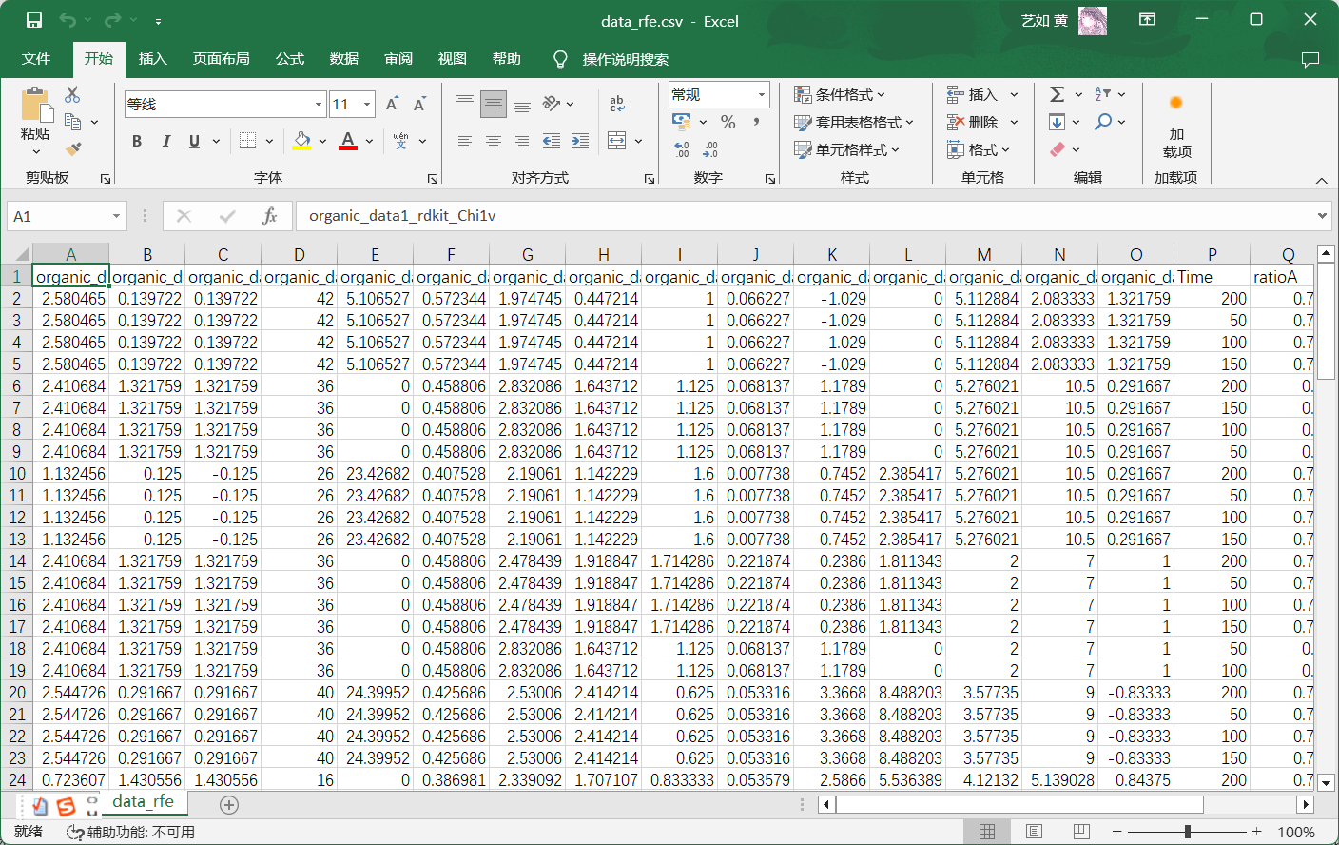
Dataset after feature selection display
Feature selection finish and the file is named as “data_rfe.csv”

Slide 12
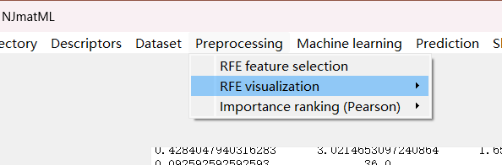
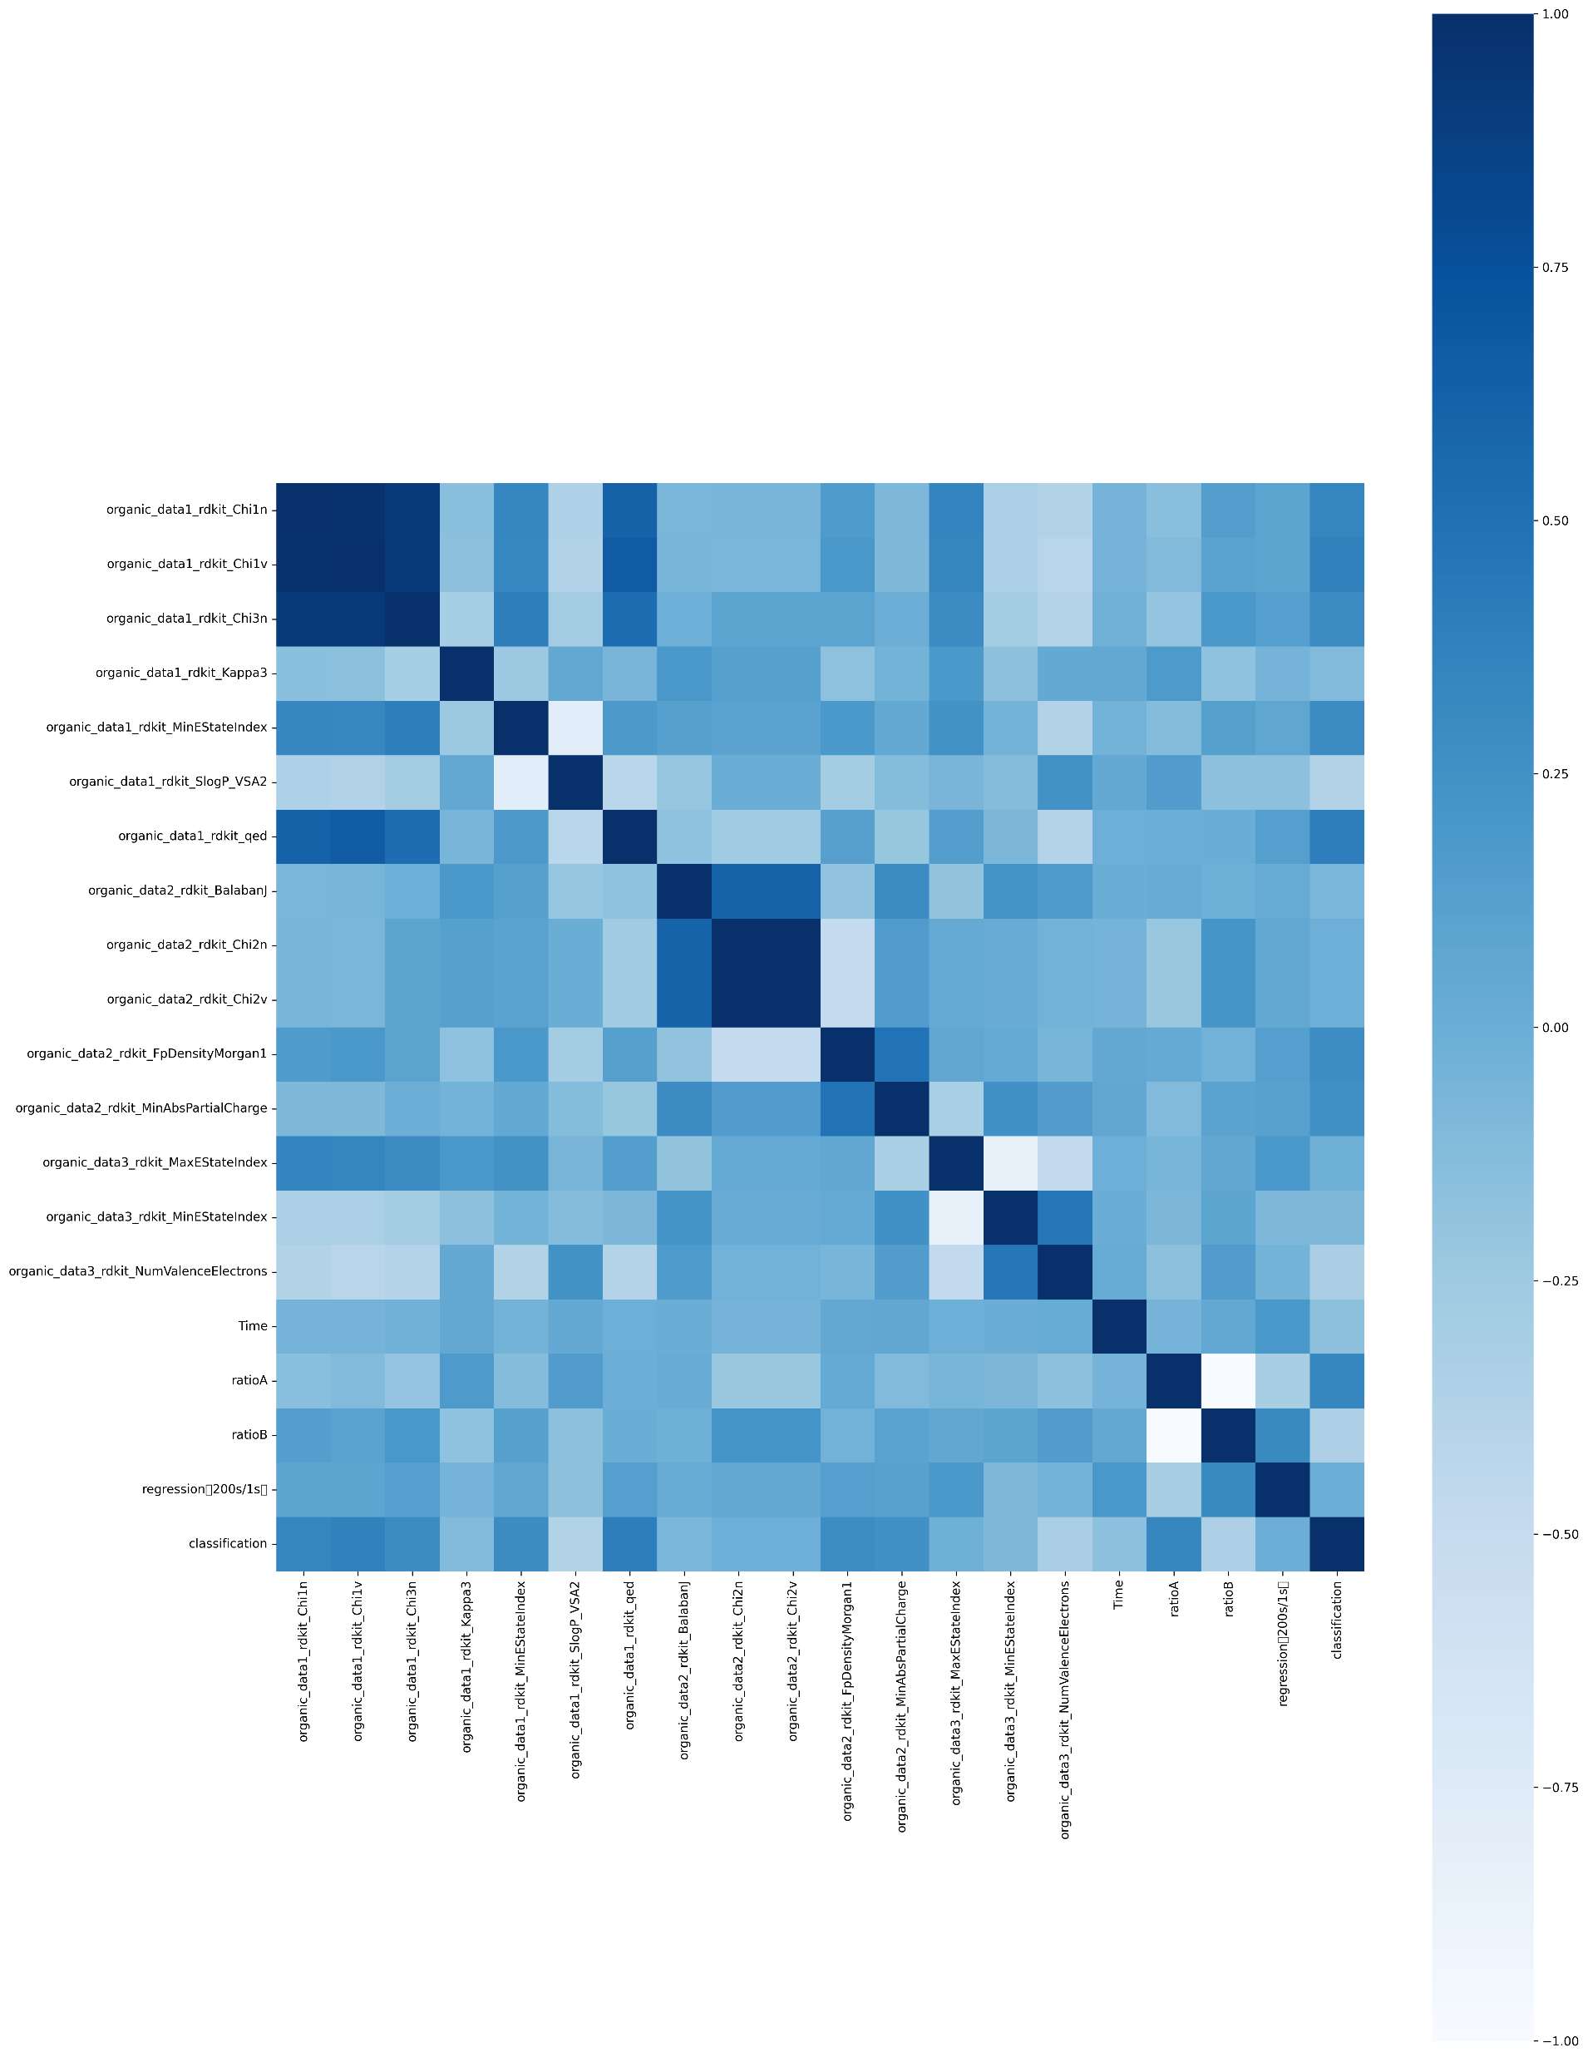
RFE visualization
Click the button “RFE visualization” and “RFE heatmap”, then you can gain:

Slide 13
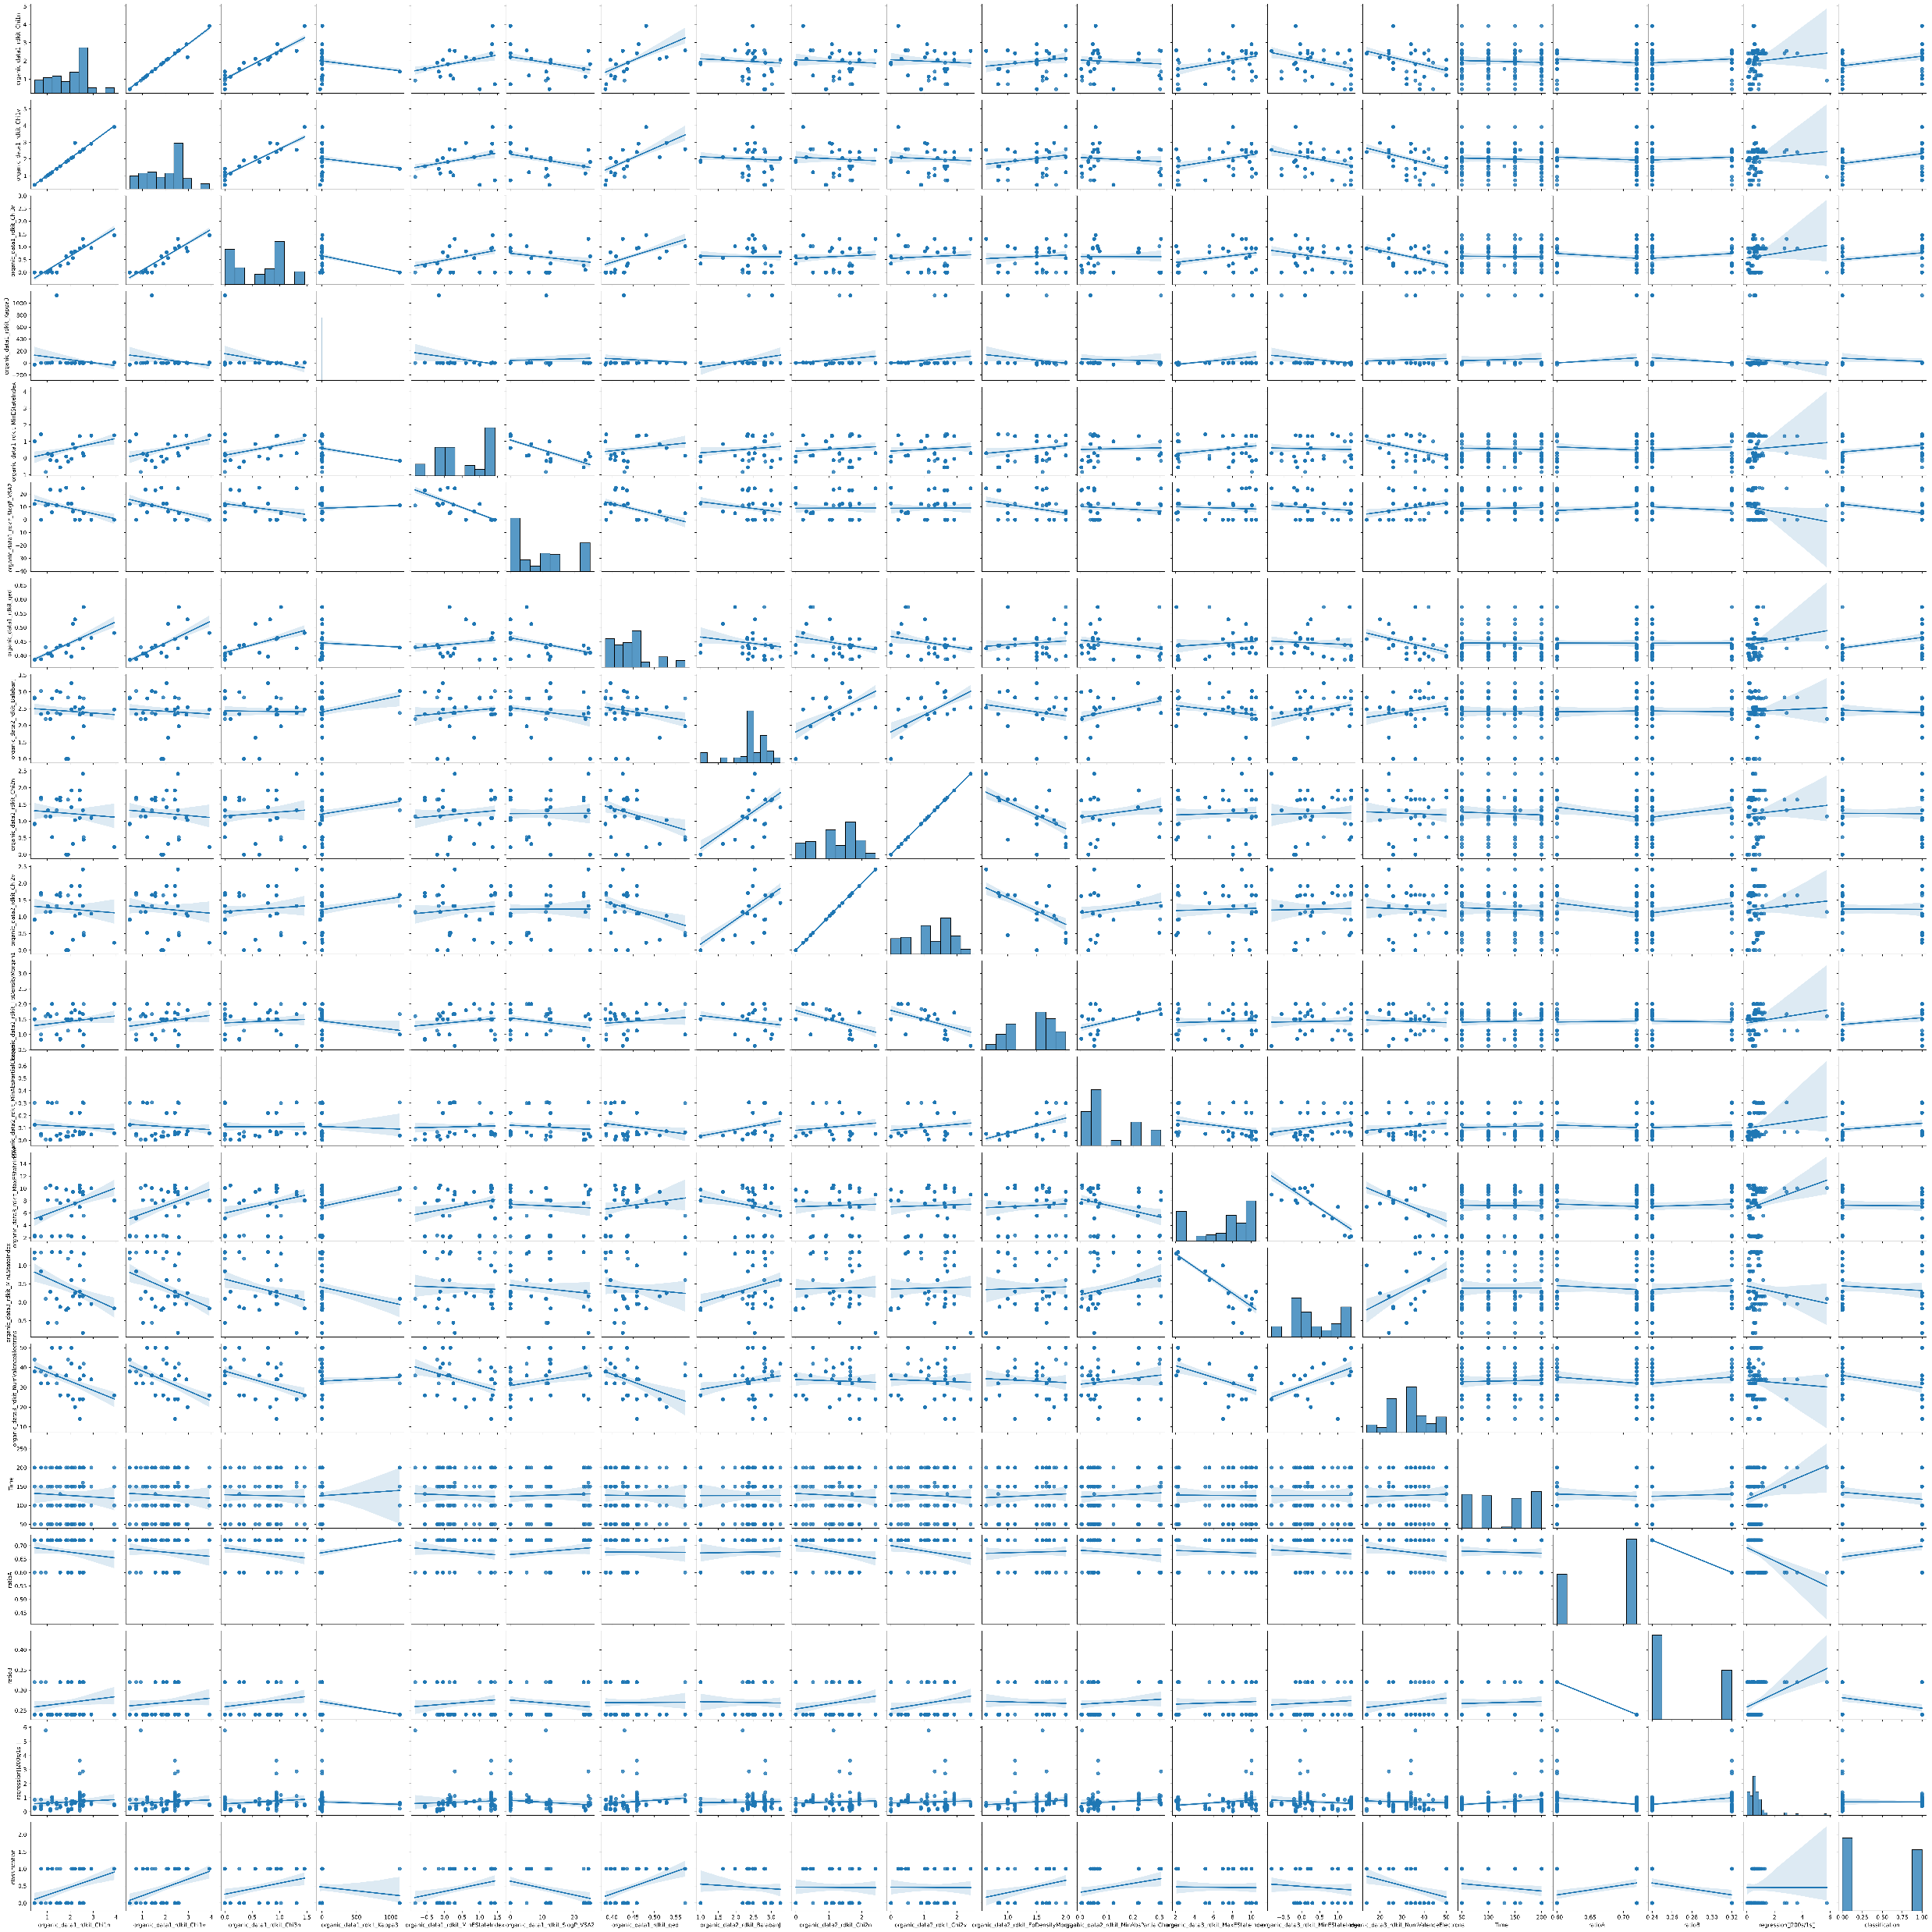
RFE visualization
Click the button “RFE pairplot”, you can gain a dataset visualization:

Slide 14
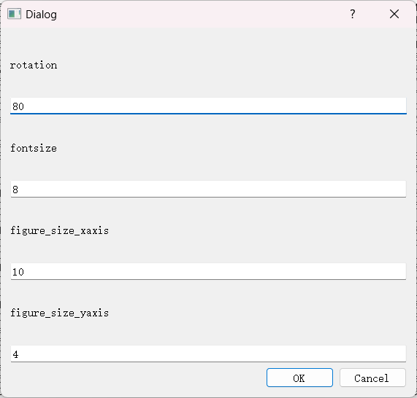
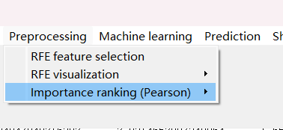
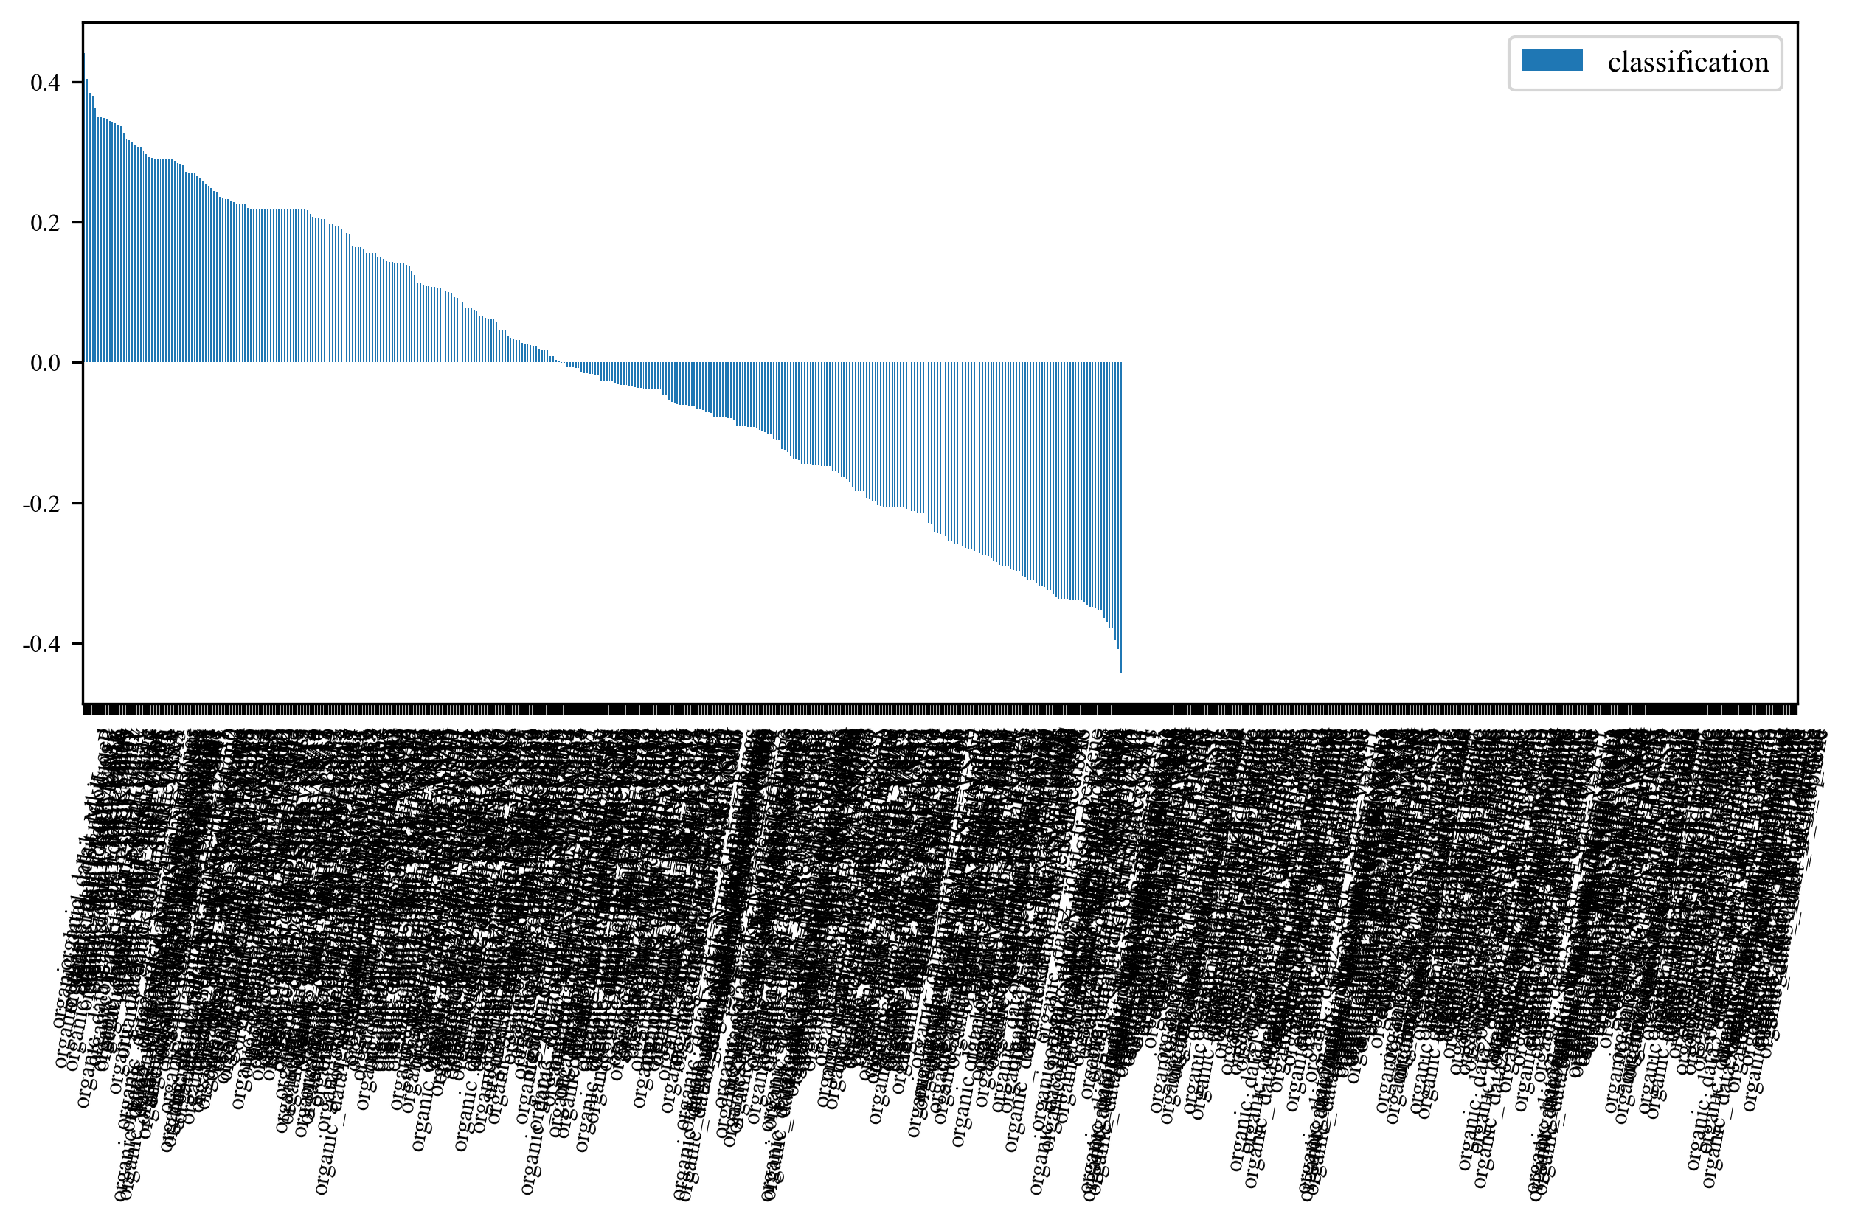
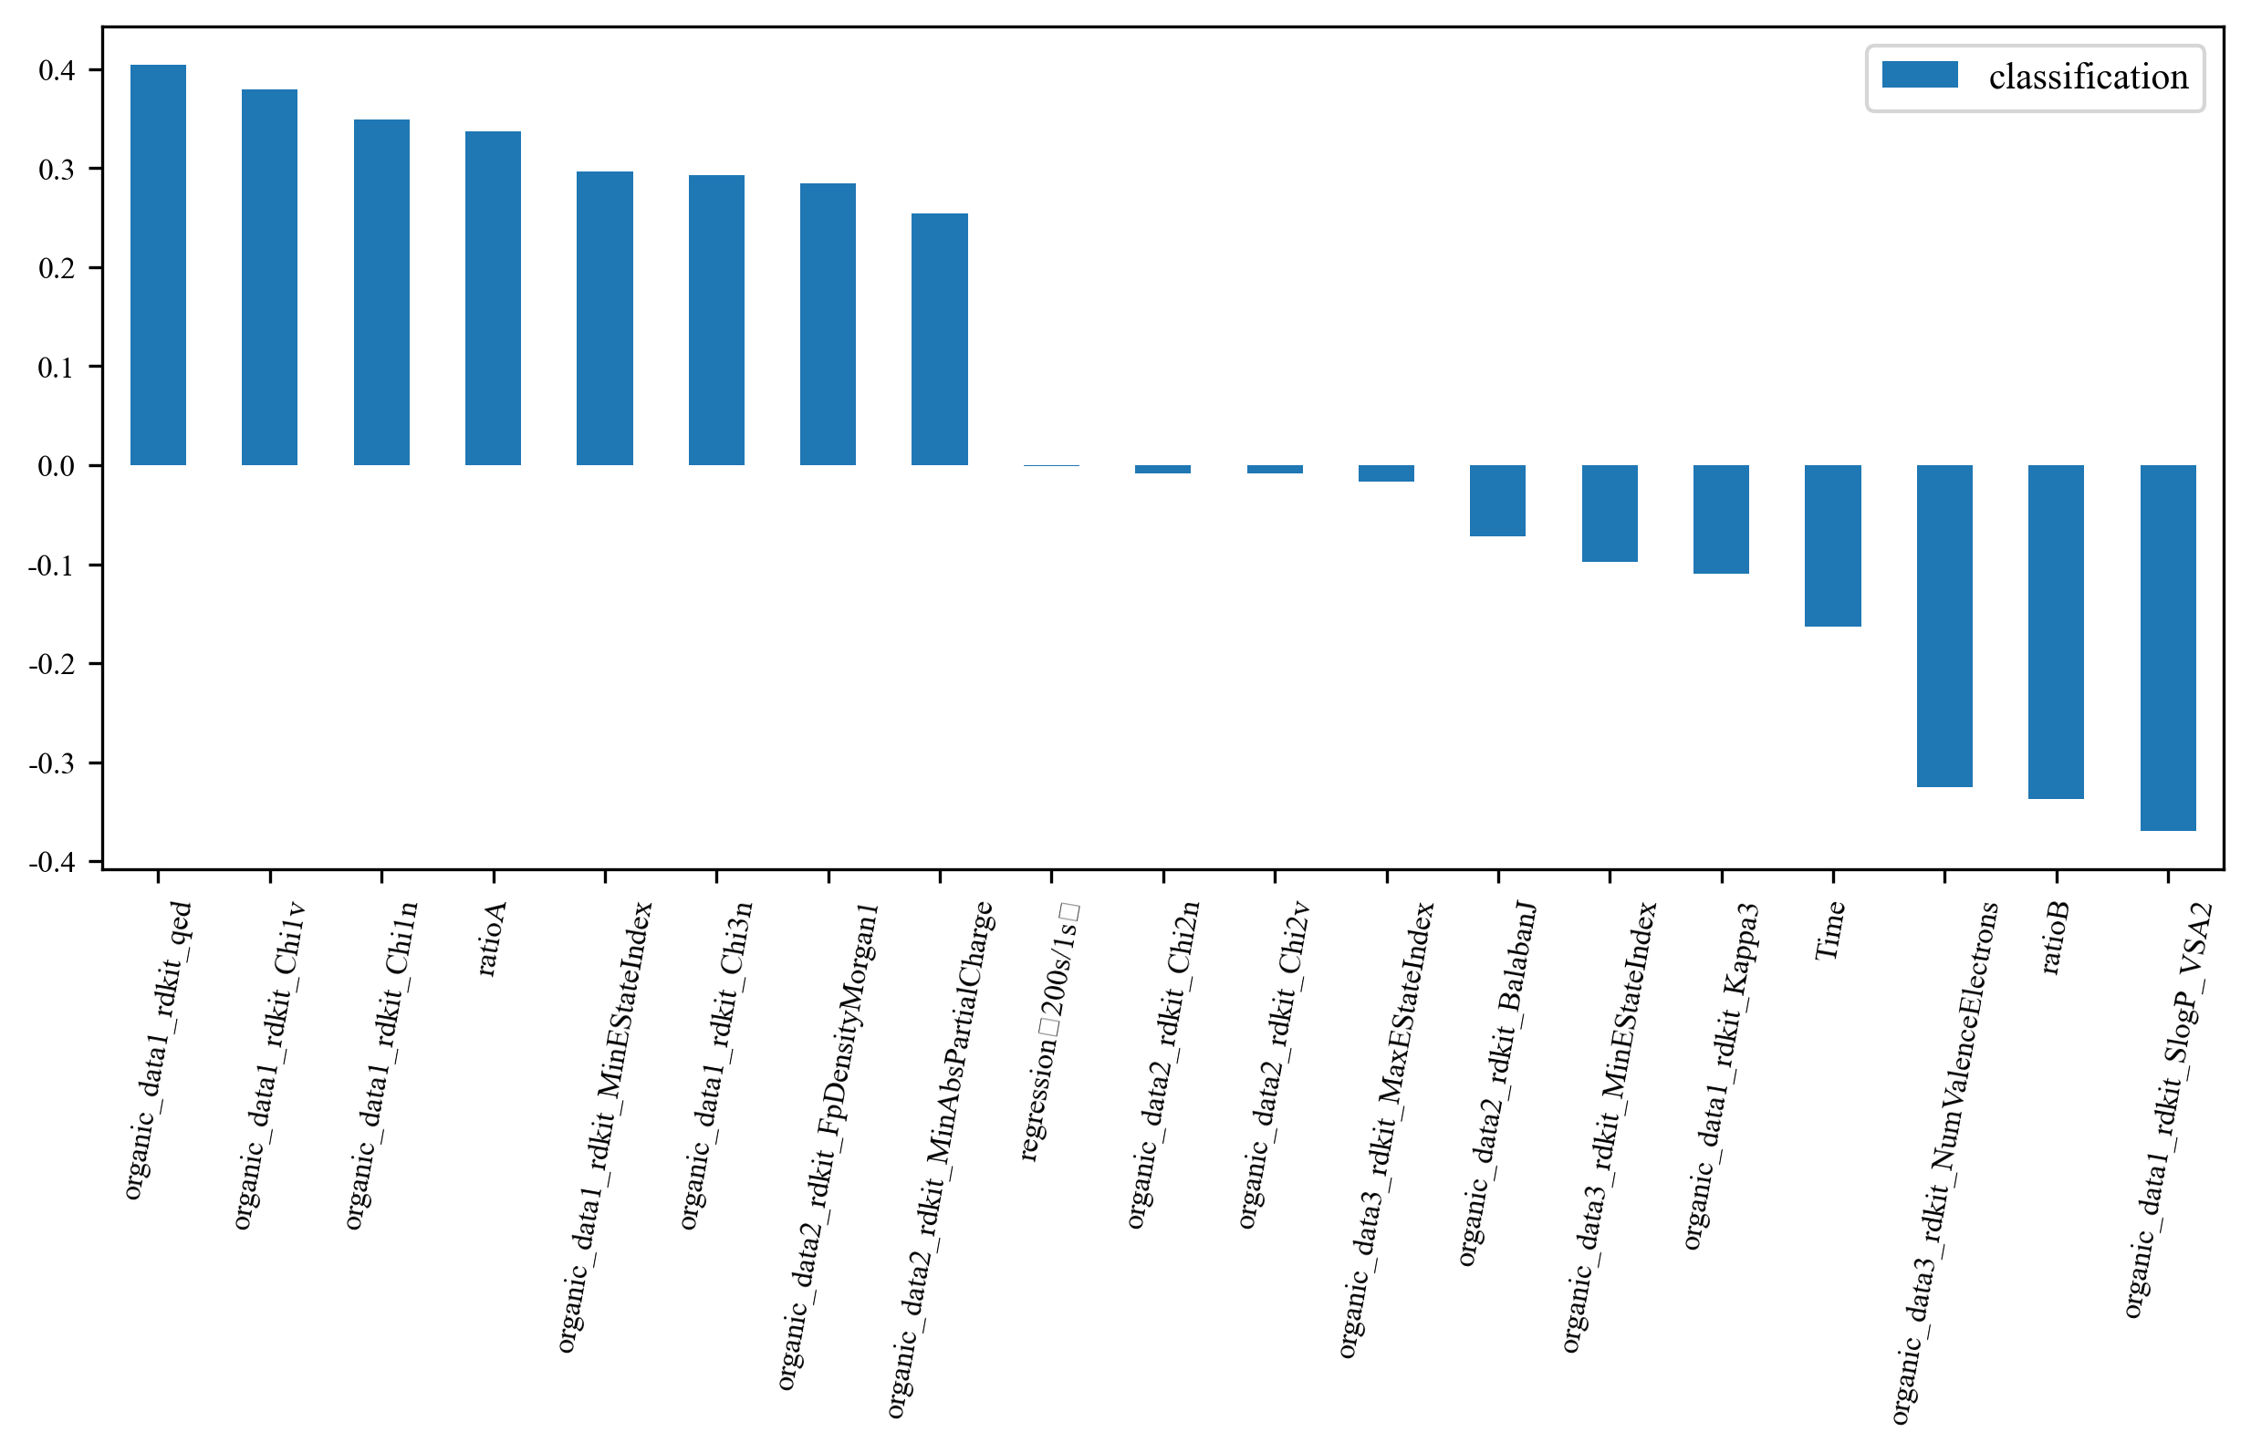
Feature importance ranking (Pearson)
Click the button “importance ranking (Pearson)”, you can gain feature importance ranking plot before and after feature selection
Parameters
Before RFE
After RFE

Slide 15
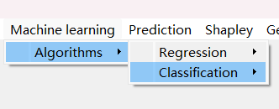
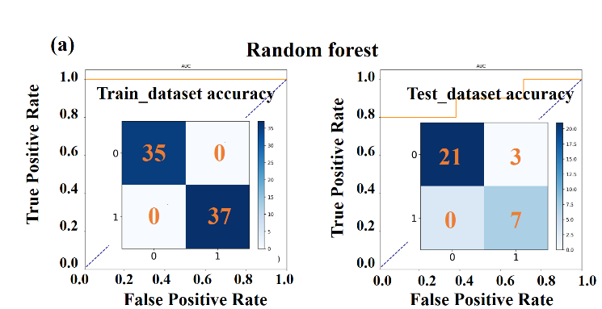
Machine learning process
Click the button “classification”, where you can choose from various algorithms, including random foresee, extra trees, gaussian process, decide trees, SVM.
For example, if you choose the random forest algorithm, you will gain confusion matrices and ROC plots based on the test dataset and the training dataset：

Slide 16
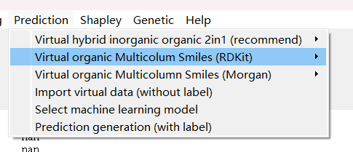
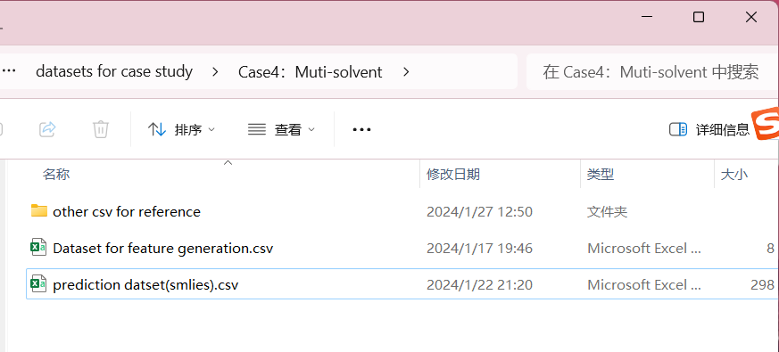
Prediction dataset generation
Click this button
Choose this file and import

Slide 17
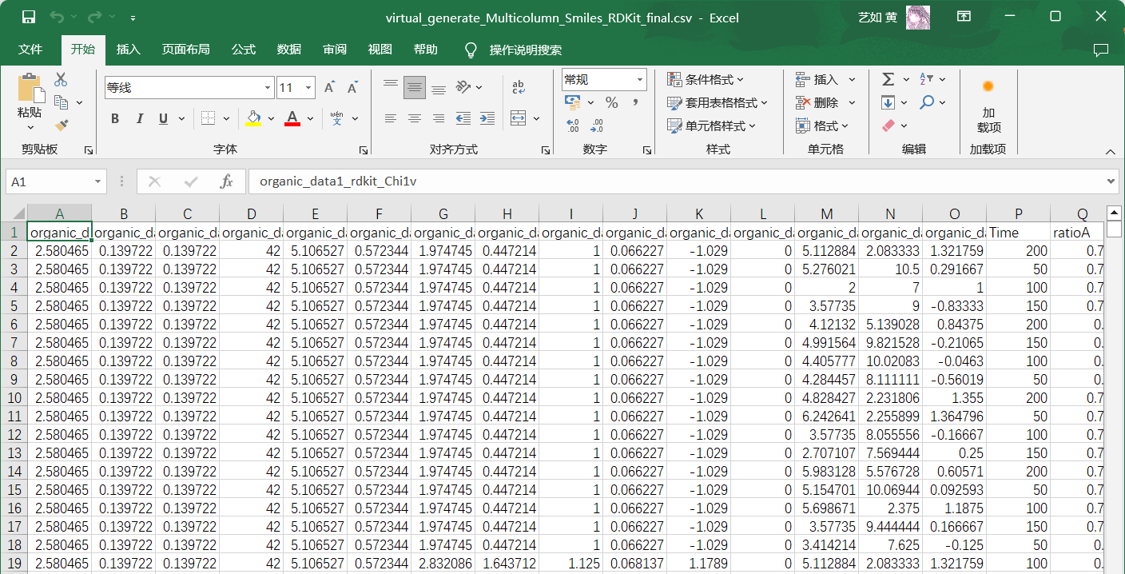
Prediction dataset generation
After data import, click the button “generation” and the prediction dataset generated:
The file named as “virtual_generate_Multicolumn_Smiles_RDKit_final.csv”

Slide 18
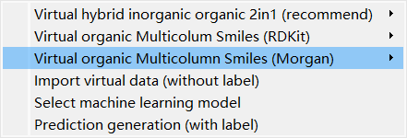
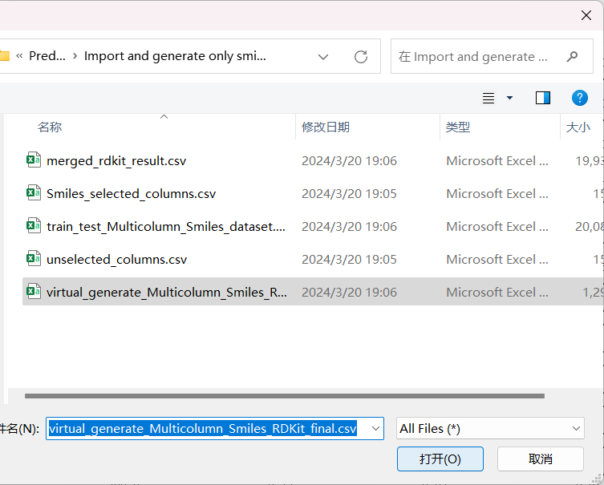
Prediction
Click this button, and input “virtual_generate_Multicolumn_Smiles_RDKit_final.csv”

Slide 19
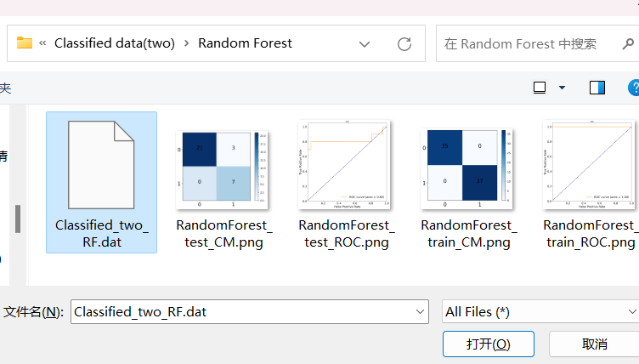
Prediction
Click this button, and input the machine learning model such as random forest:

Slide 20
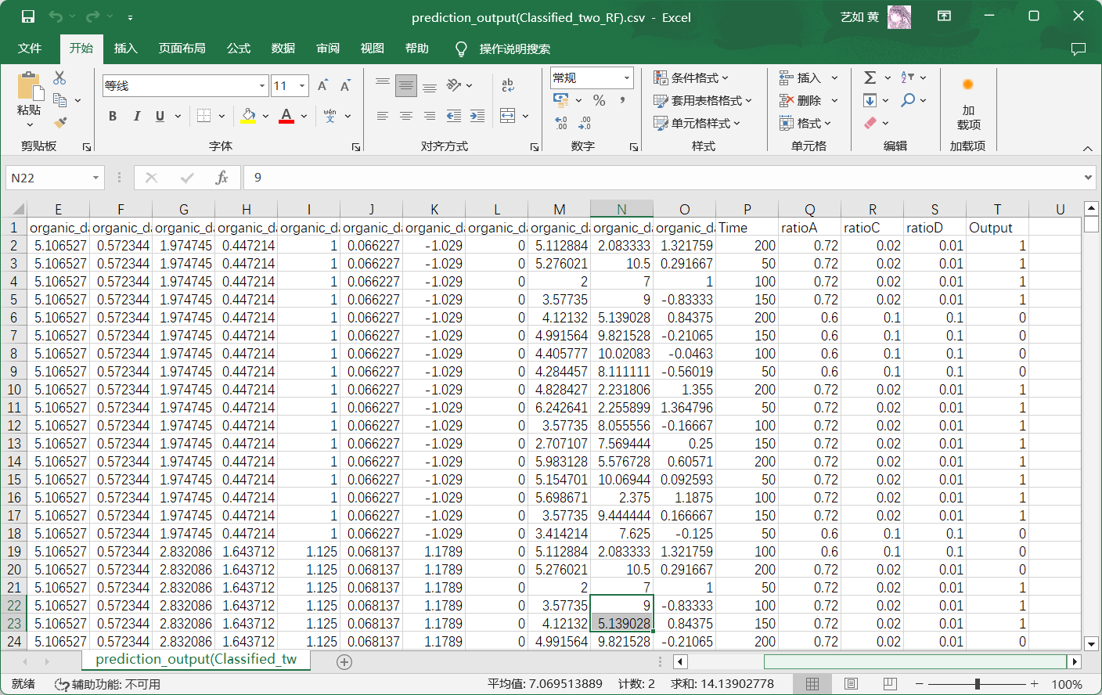
Prediction
Click the button “prediction generation (with label)”, and prediction process finish!

Slide 21
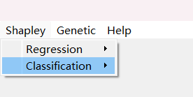
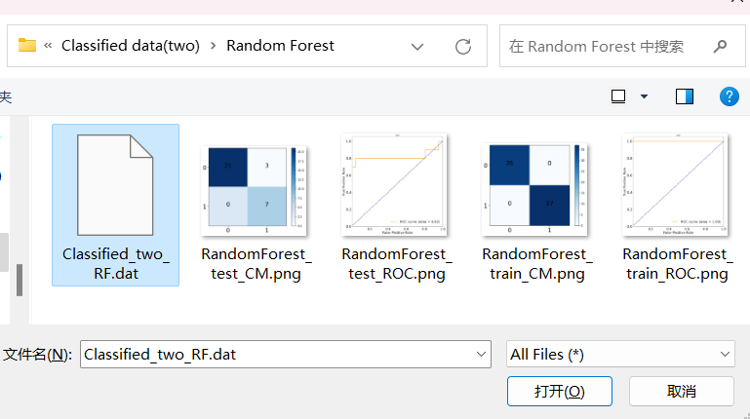
SHAP feature analysis
Click the button “Classification/Model import’’
Choose the machine learning model such as random forest:

Slide 22
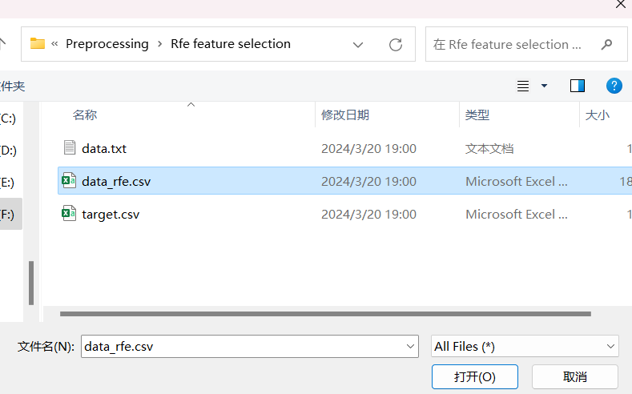
SHAP feature analysis
After model import, click the button “data import” , choose the file “data_rfe” (Path: Preprocessing\Rfe feature selection)

Slide 23
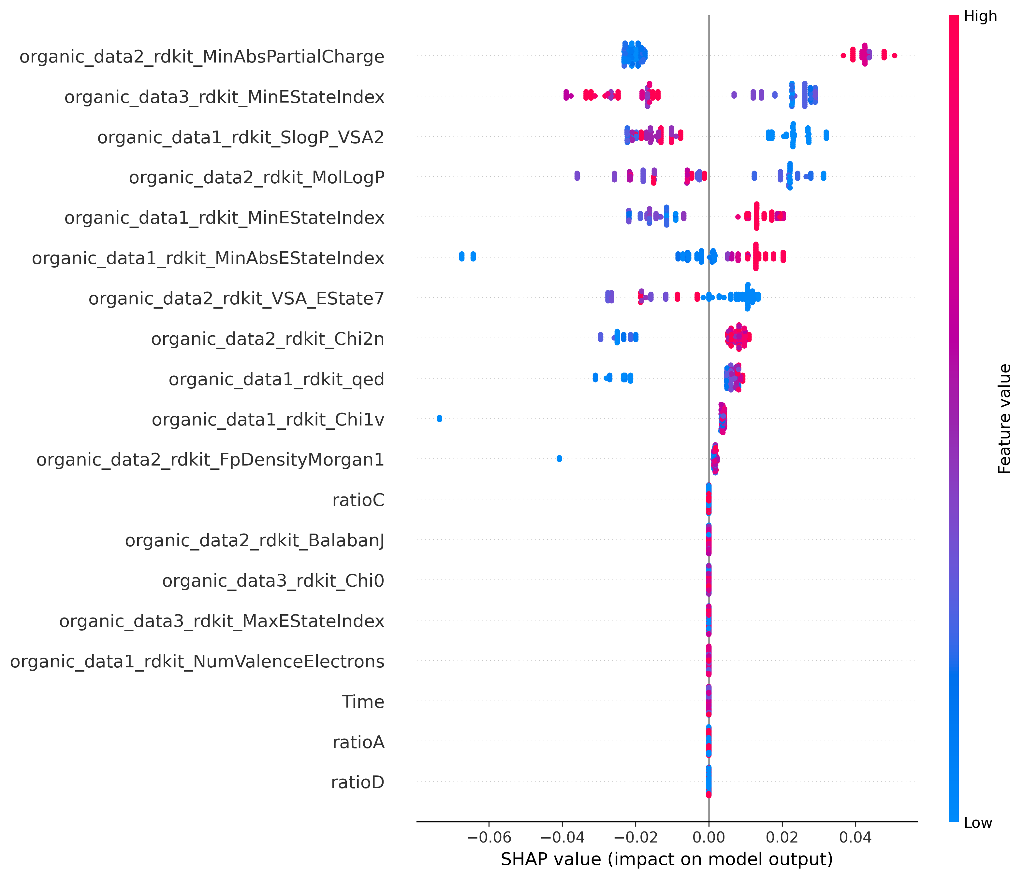
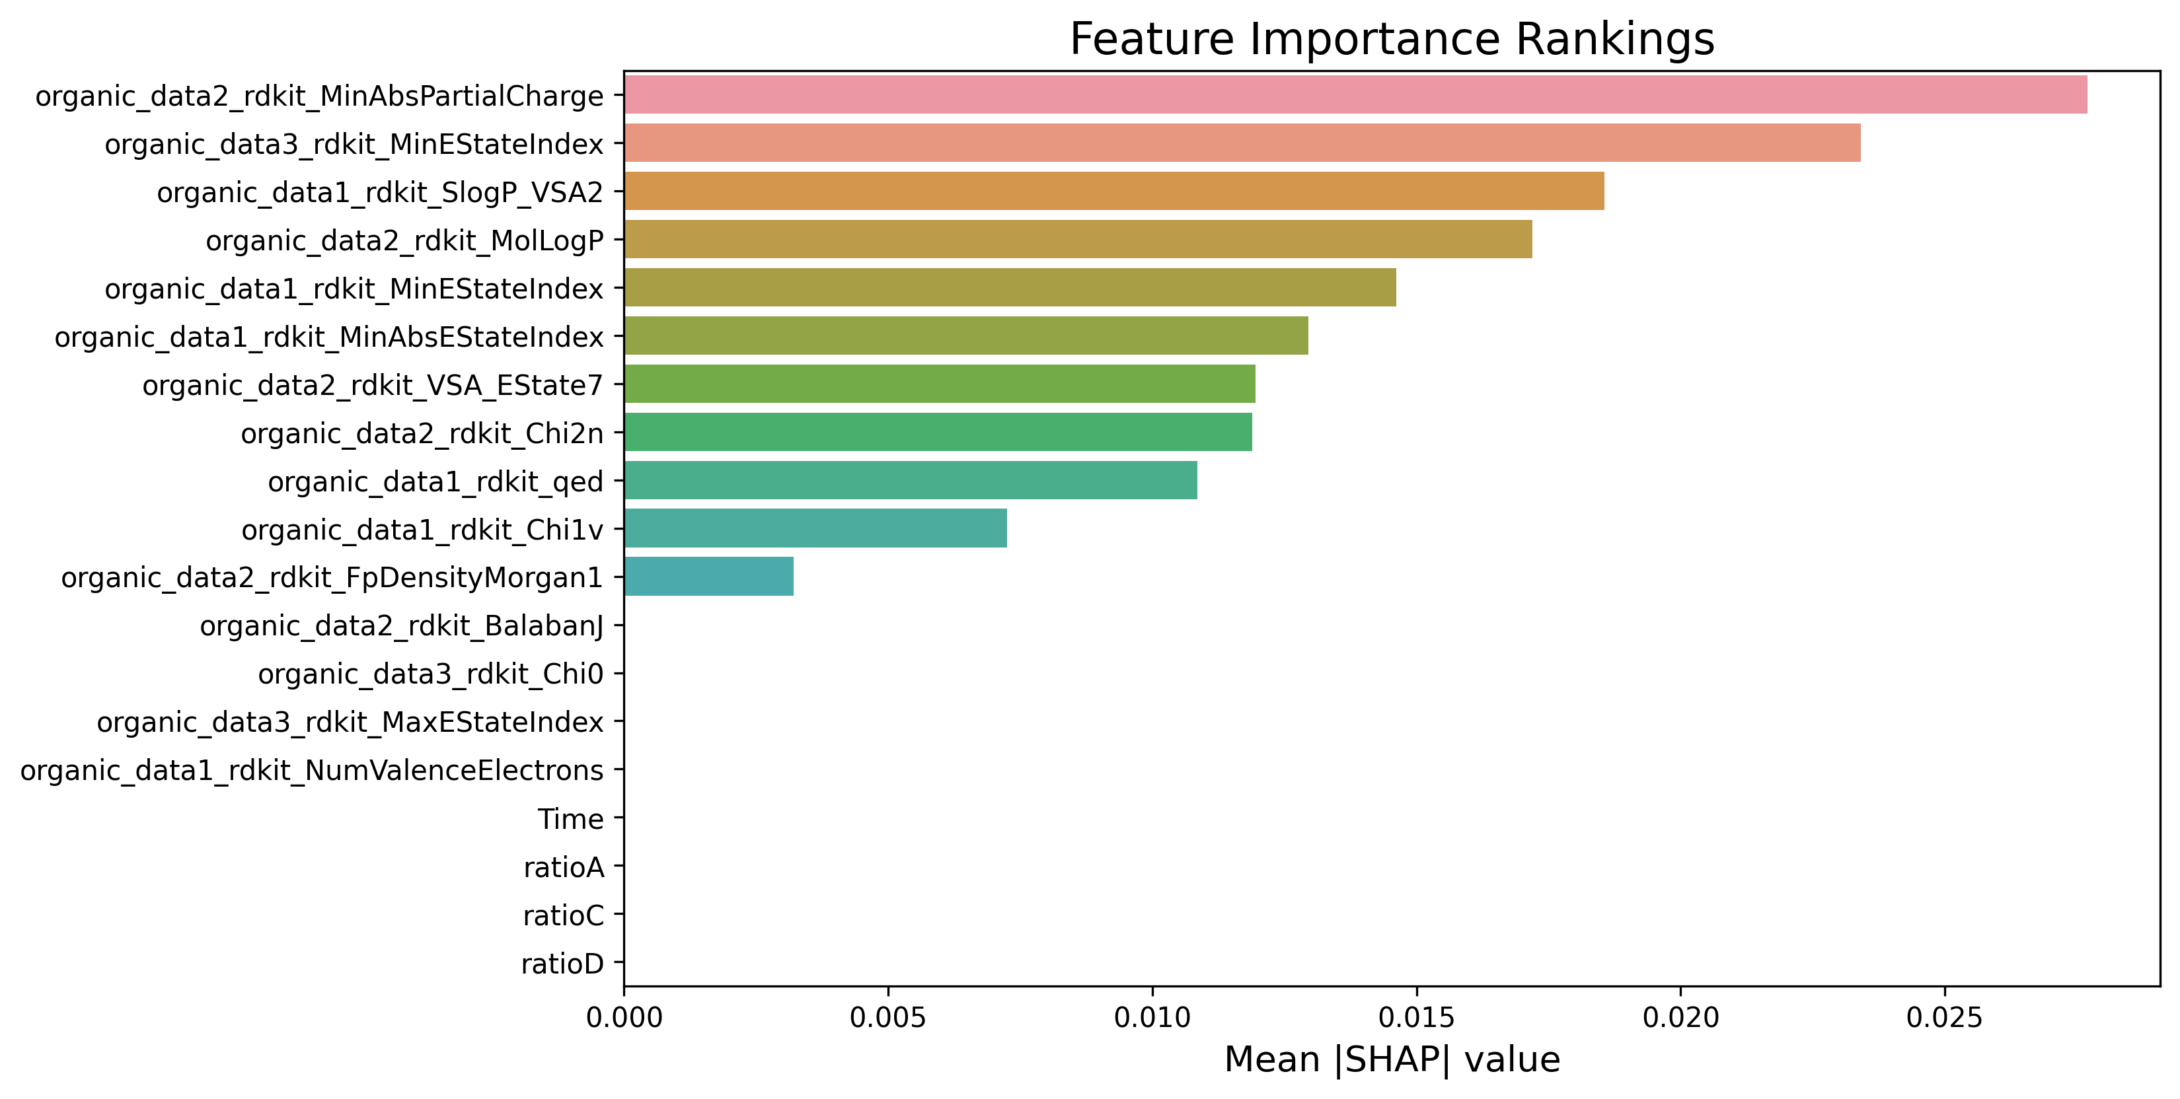
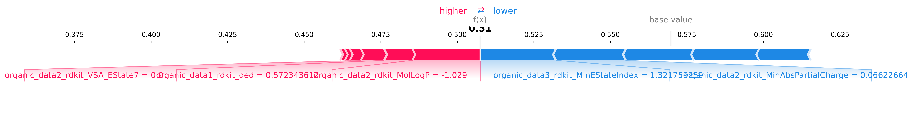
SHAP feature analysis
Click the button “Result”, and you can gain:
Feature importance ranking plot
Summary plot
Force plot

Slide 24
Thank you!

